Slide 1
Naiad Iterative and Incremental Data-Parallel Computation
Frank McSherry Rebecca Isaacs Derek G. Murray Michael Isard
Microsoft Research Silicon Valley

Slide 2
Outline
Yet another dataflow engine?
Naiad’s “differential” data model
Incremental iteration
Some performance results
The glorious future

Slide 3
Starting point
LINQ (Language Integrated Query)
Higher-order operators over collections
Select, Where, Join, GroupBy, Aggregate…
DryadLINQ
Data-parallel back-end for LINQ
Transparent execution on a Dryad cluster
Seamless* integration with C#, F#, VB.NET

Slide 4
Problem
Poor performance on iterative algorithms
Very common in machine learning, information retrieval, graph analysis, …
Stop me if you think you’ve heard this one before
while (!converged) {
// Do something in parallel.
}
Notes:
The main innovations in Naiad come from exploiting knowledge about program data to improve the performance of execution:
Declarative syntax for iteration
Data as timestamped records
Deterministic cycles in the dataflow graph
Incremental support
Mutable inputs support

Slide 5
Iterative algorithms
Added a fixed-point operator to LINQ
ys = xs.FixedPoint(x => F(x));
var ys = xs;
do {
ys = F(ys);
} while (ys != F(ys));
Collection<T> xs, ys;
F : Collection<T> -> Collection<T>

Slide 6
Single-source shortest paths
struct Edge { int src; int dst; int weight; }
struct NodeDist { int id; int dist; int predecessor; }
Collection<NodeDist> nodes = { (s,0,s) }; /* Source node. */
Collection<Edge> edges = /* Weighted edge set. */
return nodes.FixedPoint(
x => x.Join(edges, n => n.id, e => e.src,
(n, e) => new NodeDist(e.dst, n.dist + e.weight, e.src))
.Concat(nodes)
.Min(n => n.id, n => n.dist)
);

Slide 7

Terminate when
$$f^{N}\left(x\right)=f^{N−1}\left(x\right)$$
Notes:
Now if you’re computing the fixed point of F, and that fixed point exists, there will come a point when f^{i+1}(x) equals f^i(x).

Slide 8
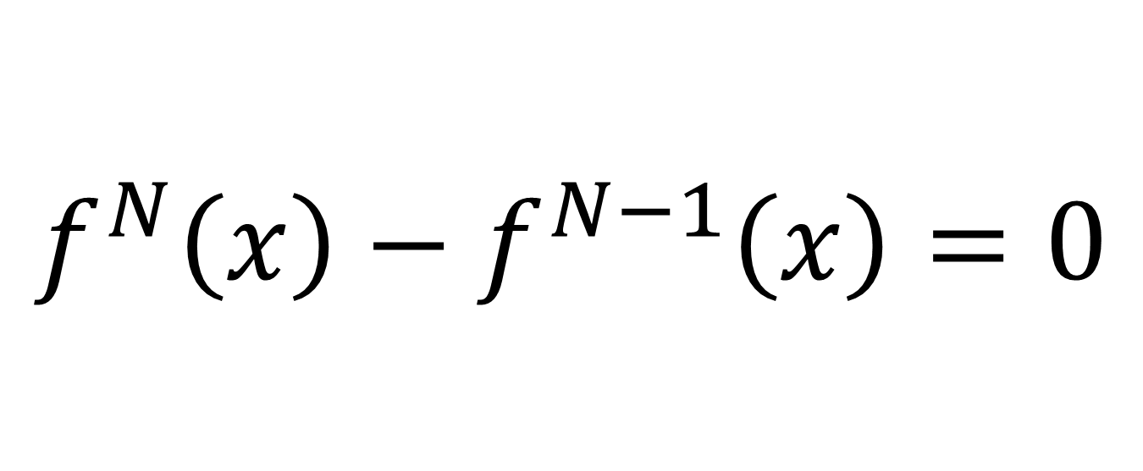
Terminate when
$$f^{N}\left(x\right)−f^{N−1}\left(x\right)=0$$

Slide 9
The more it iterates…
Notes:
Strongly connected components has an outer loop and an inner loop.
Here’s what happens in the first iteration of the outer loop: at first a lot of things change, then it flattens out for a while, and finally there’s a quite-long tail where very little happens each round.
In the second outer loop iteration, there’s less work to begin with, and it actually increases a bit, before tailing off as before.
In the third outer loop iteration, there’s hardly anything, and the inner loop terminates much sooner. And so on for nine iterations of the outer loop. The problem with many existing iterative frameworks is that they reprocess the whole data set for each inner loop iteration, which means they waste a lot of time recomputing things that haven’t changed.
The main idea in Naiad is to make the notion of “change” between iterations first class, and we do that with the “differential data model”.

Slide 10
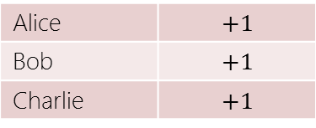
Differential data model
$$t_{1}$$
$$t_{2}$$
Alice
Alice
Bob
Alice
Bob
Charlie
Collection
Weighted Collection
Alice | $$+2$$
Bob | $$+1$$
Alice | $$+1$$
Bob | $$+1$$
Charlie | $$+1$$
Alice | $$@t_{1}$$ | $$+2$$
Bob | $${@t}_{1}$$ | $$+1$$
Alice | $${@t}_{2}$$ | $$−1$$
Charlie | $${@t}_{2}$$ | $$+1$$
Difference
Notes:
Like many data-parallel frameworks, the fundamental data type in Naiad is a collection. Naiad collections are special because they are time varying. For now, let’s assume a time line with logical timestamps t_1 and t_2, where t_1 precedes t_2. (In general, Naiad logical time can form a lattice, but that’s not important right now.)

Slide 11

Programmer view
Collection$\left(t\right)=\sum_{s≤t}{\text{Difference}(s)}$
Efficient implementation

Slide 12
Data-parallel execution model
Collection A
Collection B
Operator
Operator divided into shards using partition of some key space
Each shard operates on a part
Each edge may exchange records between shards

Slide 13
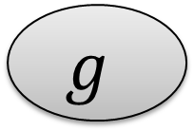
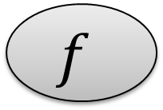
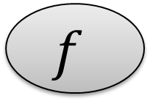
$$f$$
$$f$$
$$f$$
Hash Partition
$$g$$
$$g$$
$$g$$
shard
shard
shard

Slide 14
Naiad operators
Unary, stateless
Select
SelectMany
Where
Binary, stateless
Concat
Except
Unary, stateful
Min, Max, Count, Sum
GroupBy
FixedPoint
Binary, stateful
Join
Union

Slide 15
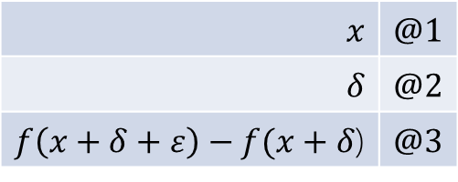
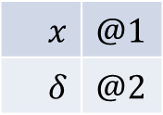
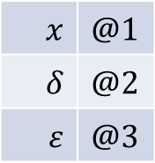
Incremental unary operator
$$x$$ | $$@1$$
$$δ$$ | $$@2$$
$$ε$$ | $$@3$$
$$x$$ | $$@1$$
$$δ$$ | $$@2$$
$$x$$ | $$@1$$
$$x$$ | $$@1$$
$$δ$$ | $$@2$$
$f\left(x+δ+ε\right)−f(x+δ$) | $$@3$$
$$x$$ | $$@1$$
$$f\left(x+δ\right)−f(x)$$ | $$@2$$
$$f(x)$$ | $$@1$$
$$f$$
Note that many operators are linear, i.e. $f\left(x+δ\right)=f\left(x\right)+f(δ)$, greatly simplifying the computation
Notes:
Now let’s see what happens when we allow the input collection to vary. Here, I’m going to assume that f is totally opaque.
We start at time 1 with an input x. Straightforwardly enough, this results in the output f(x) at time 1.
At time 2, we add delta to the input. What happens? Well the desired output is f(x+delta), but the operator’s already output f(x), so it has to rescind it. This means that the output at time 2 is f(x+d) – f(x).
Now at time 3 we add epsilon to the input. The same thing happens: we emit f(x+d+e) and rescind the previous output f(x+d).
This might seem like a load of work, but many of the operators we have to deal with are linear. That is to say (click) that f(x+d) = f(x) + f(d). This simplifies the computation greatly: if f is linear here, we can rewrite f(x+d) so that the f(x) terms cancel at time 2, and the f(x+d) terms cancel at time 3.

Slide 16
Stateless unary operator
Alice | $${@t}_{1}$$ | $$+1$$
$$f(\text{Alice})$$ | $${@t}_{1}$$ | $$+1$$
$$f$$
e.g. Select(x => f(x))
Notes:
Note that this is the only kind of cycle that we allow in Naiad programs.

Slide 17
Stateful unary operator
$$(\text{Bob}, 16)$$ | $$@1$$ | $$+1$$
$$(\text{Bob}\text{,} 37)$$ | $$@2$$ | $$+1$$
$$(\text{Bob}, 16)$$ | $$@3$$ | $$−1$$
$$(\text{Bob}, 37)$$ | $$@3$$ | $$+1$$
$$min$$
Bob | 16
Bob | 16, 37
Bob | 37
e.g. Min(x => x.Key, x => x.Value)
Notes:
Example of min.
Note that this is a non-standard kind of min, which suits us as it’s data parallel: it includes selectors to get the key and value. Typically there would also be a result selector, but we imply that this is x=>x. If you’re a LINQ afficionado, you might imagine this as GroupBy(x => x.first).Min(x => x.second).
New input comes in for key Bob at time 1 with value 16, so we create an entry in the state for it. (This is a simplified view of the state, which also includes a lot more bookkeeping for times). As we only have one record, this is the minimum, so we push it out the output.
Let’s say now we get another record for Bob with value 37. It’s larger than the current minimum, so don’t push it out but keep a note of it. Why?
Well, Naiad supports mutable inputs, so whoever is producing the data can decide to rescind the original Bob-16 record. She would do this by sending in a negatively-weighted Bob-16 record. When this happens, the state is updated again, 37 becomes the smallest value, so the operator sends two outputs. First it rescinds its previous value for the min, by sending on the negatively-weighted Bob-16 at time 3. Then it emits a new record, saying Bob-37 is the new minimum at time 3.
If we get a whole bunch of updates at the same time, we don’t eagerly push out updates, and rather consolidate them until all of the updates at the current time are received. This is conservative – see later.

Slide 18
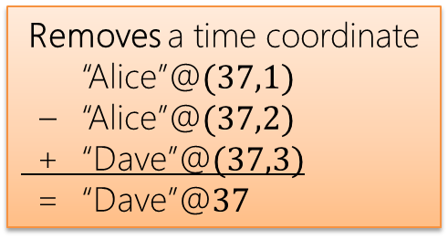
Fixed-point operator
IN
$$f$$
OUT
Adds a time coordinate
“Bob”@$37$ → “Bob”@$(37,0)$
Removes a time coordinate
“Alice”@$(37,1)$ – “Alice”@$(37,2)$ + “Dave”@$(37,3)$ = “Dave”@$37$
Increments innermost time coordinate
“Eve”@$(37,1)$ → “Eve”@$(37,2)$
Notes:
Note that this is the only kind of cycle that we allow in Naiad programs.

Slide 19
Scheduling in cyclic graphs
$$f$$
Want deterministic results
FP must choose between two edges
Timing of feedback may be non-deterministic
Stateful operators process in timestamp order
Incrementer on back-edge ensures no ambiguity
Notes:
Essentially, time only increases along a path, and strictly increases on a cycle.

Slide 20
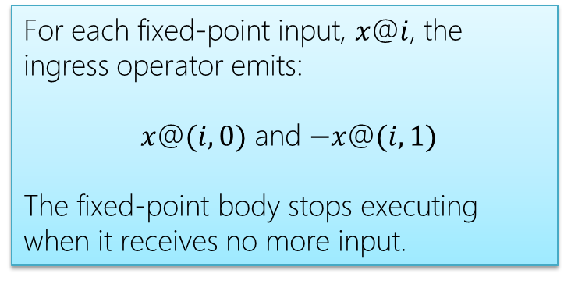
Detecting termination
Naïve solution
Store complete previous result
Compare with current result
Better solution
Compute a distance metric between current and previous result
Naiad solution
For each fixed-point input, $x$@$i$, the ingress operator emits:
$x$@$(i,0)$ and $−x$@$(i,1)$
The fixed-point body stops executing when it receives no more input.
Notes:
The incrementer accumulates records at each time, and iteration terminates at the first time $\left(i,j\right)$ for which no records are produced

Slide 21
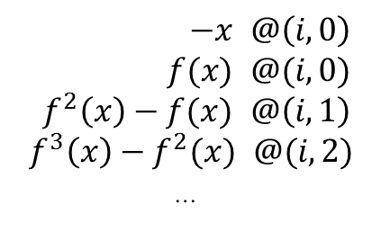
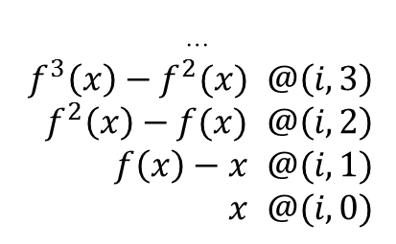
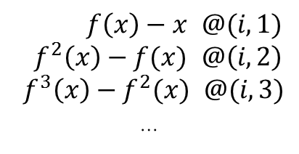
Incremental fixed-point
…
$f^{3}\left(x\right)−f^{2}(x)$ $@\left(i,3\right)$
$f^{2}\left(x\right)−f(x)$ $@\left(i,2\right)$
$f\left(x\right)−x$ $@(i,1)$
$x$ $@(i,0)$
…
$f^{4}\left(x\right)−f^{3}(x)$ $@\left(i,3\right)$
$f^{3}\left(x\right)−f^{2}(x)$ $@\left(i,2\right)$
$f\left(f(x)\right)−f(x)$ $@\left(i,1\right)=f^{2}\left(x\right)−f\left(x\right)@(i,1)$
$f(x)$ $@(i,0)$
$$x@i$$
IN
$$f$$
OUT
$$\lim_{n→∞}{f^{n}(x)} @i$$
$f\left(x\right)−x$ $@(i,1)$
$f^{2}\left(x\right)−f(x)$ $@\left(i,2\right)$
$f^{3}\left(x\right)−f^{2}(x)$ $@(i,3)$
…
$−x$ $@\left(i,0\right)$
$f(x)$ $@(i,0)$
$f^{2}\left(x\right)−f(x)$ $@\left(i,1\right)$
$f^{3}\left(x\right)−f^{2}(x)$ $@(i,2)$
…
Notes:
This is perhaps the most important slide in the deck: it explains what happens when (click), input x arrives at time i to a fixed point computation.
So as I said earlier, when x@i comes along, the ingress vertex emits x@(i,0) and negative x@(i,1). To simplify the illustration, I’ve put –x@(i,0) right before the incrementer, which is equivalent to –x@(i,1).
We schedule in time order, so the earliest records are on the input to f, and this produces f(x)@(i,0) on the output of f. This also gets copied to the feedback edge. On the feedback edge we now have –x + f(x) @(i,0) which the incrementer turns into (f(x)-x)@(i,1).
This gets added in to the input to f. Before the input was x; now it’s x + f(x) – x… which is exactly f(x). Remember how we deal with changes to the input. The new output, at time (i,1) is f(f(x)) [the new output] minus f(x) [the old output]. Let’s write that as f^2(x)-f(x). If at this point we consolidate the output differences, we get f^2(x), which is just what we want!
Now the cycle is well established. F^2(x)-f(x) gets fed to the incrementer, which increments its time to (i,2). The f(x) and the x terms cancel, so the new input to f is f^2(x). This goes on and on, until the additional input to f [point to bottom-left corner] becomes empty. At this point, we stop scheduling the f vertex, and run the egress node, which consolidates things – adds up all of the differences – and emits the fixed point.

Slide 22
Composability
FixedPoint body can contain a FixedPoint
Add another component to the timestamp
FixedPoint is compatible with incremental update
Add another component to the timestamp
FixedPoint is compatible with “prioritization”
Add another component to the timestamp

Slide 23
Prioritization
Hints to control the order of execution
Programmer can prioritize certain records, based on their value
In SSSP, explore short paths before long paths
1
1
1
100

Slide 24
Implementation
Currently implemented for multicore only
Shards statically assigned to cores
Inter-shard communication implemented by passing pointers via concurrent queues
Evaluated on a 48-core AMD Magny Cours

Slide 25
Sample programs
Single-source shortest paths
Synthetic graphs, 10 edges per node
Connected components
Uses FixedPoint to repeatedly broadcast node names, keeping the minimum name seen
Amazon product network graph, 400k nodes, 3.4m edges
Strongly connected components
Invokes CC as a subroutine, contains a doubly-nested fixed point computation
Synthetic graphs, 2 edges per node
Smith-Waterman
Dynamic programming algorithm for aligning 2 sequences
Notes:
CC: undirected graph, on a directed graph only determines reachability
SCC: directed graph, removes edges if not in same strongly connected component, ie forward or backward reachability returns different node names for 2 components, converges to the edges in the same component

Slide 26
Some numbers
Comparing Naiad with LINQ on single-threaded executions:
Program | Edges | Running time (s) LINQ | Running time (s) Naiad | Memory (MB) LINQ | Memory (MB) Naiad | Updates (ms) Naiad
SSSP | 1M | 11.88 | 4.71 | 386 | 309 | 0.25
SSSP | 10M | 200.23 | 57.73 | 1,259 | 2,694 | 0.15
SCC | 200K | 30.56 | 4.36 | 99 | 480 | 1.12
SCC | 2M | 594.44 | 51.84 | 514 | 3,427 | 8.79
CC | 3.4M | 66.81 | 9.90 | 1,124 | 985 | 0.49
Naiad is a lot faster...
...but memory footprint is greater
Notes:
MAKE THESE NUMBERS READABLE

Slide 27
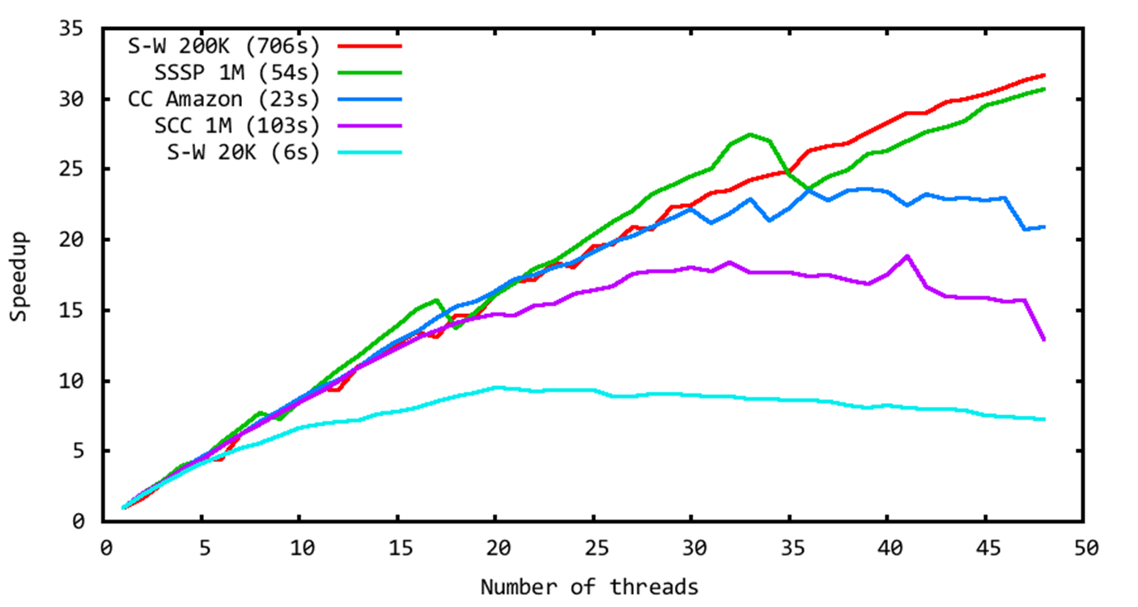
Scaling

Slide 28
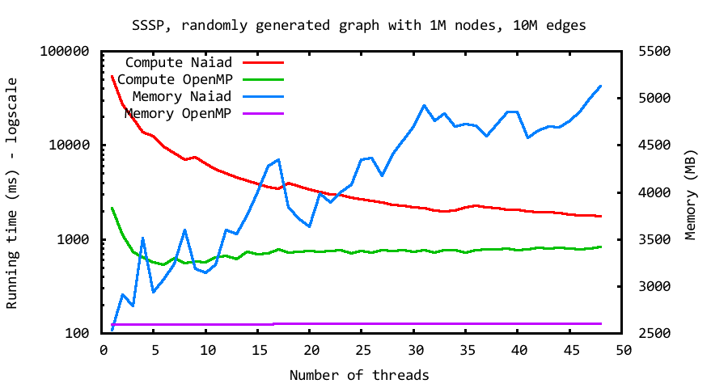
Comparison with OpenMP
Notes:
Absolute running time is about 10 times faster for OpenMP, using half the memory on 48 cores.

Slide 29
Bellman-Ford using OpenMP
while (!done) {
done = true;
#pragma omp parallel for num_threads(numthreads)
for (int i=0; i<numedges; i++) {
edge *uv = &edges[i]; // next edge
node *u = &nodes[uv->u]; // source node
node *v = &nodes[uv->v]; // destination node
long dist = u->d + uv->w; // new distance to v through u
long old = v->d; // old distance to v
if (dist < old) { // if new is better, update it
long val =
InterlockedCompareExchange((long*)&v->d, dist, old);
// keep looping until no more updates
if (val == old && done) done = false;
}
}
}
Notes:
if (val == old) will be true if the CAS succeeds in updating v->d
sort edges by destination node to improve locality
use CAS not Critical Section
in testing it turned out that this version worked better than only looking at the edges for nodes that are under consideration: even though less data touched, ran slower. Naive version is a sequential scan, so good for prefetching.

Slide 30
Bellman-Ford in NaiadLINQ
struct Edge { int src; int dst; int weight; }
struct Node { int id; int dist; int predecessor; }
return nodes.FixedPoint(
x => x.Join(edges, n => n.id, e => e.src,
(n, e) => new Node(e.dst, n.dist + e.weight, e.src))
.Concat(nodes)
.Min(n => n.id, n => n.dist)
);

Slide 31
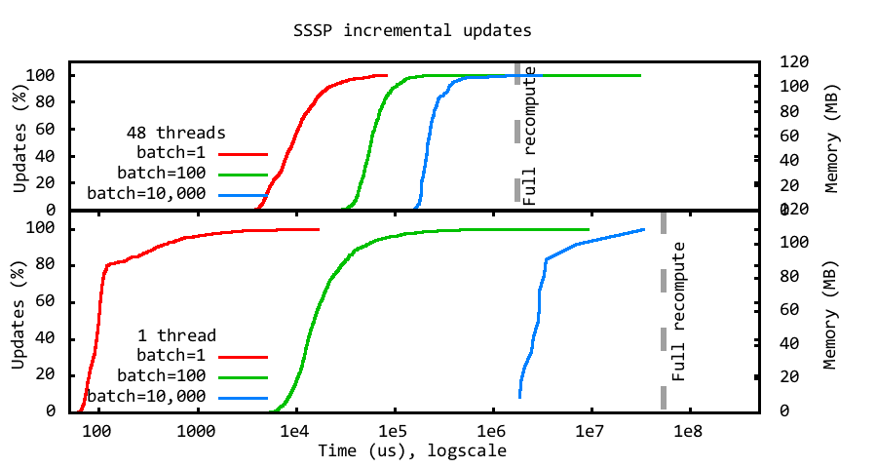
Incremental updates
Notes:
Bottom 1 thread; top 48 threads. Note the the x axis is logscale, so speedup is pretty good.
Main takeaway: making an incremental update is almost always faster than doing a full recompute (speculate that the long tail on 48 cores is GC intrusion). Very small updates are faster on a single core because there’s a bunch of synchronization overhead. Larger batches are faster on more cores because there’s more work to do and hence parallelize.

Slide 32
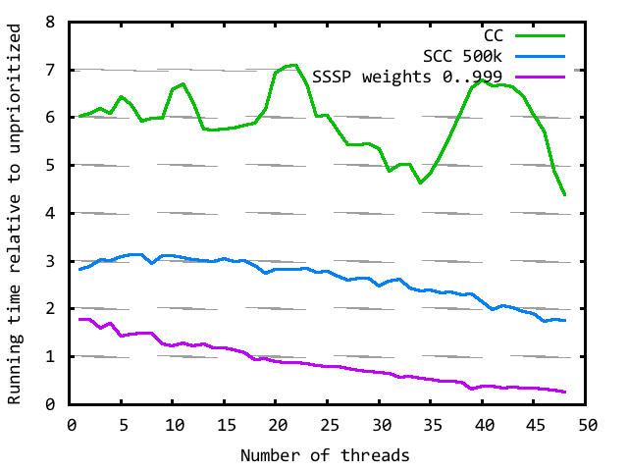
Prioritized execution
Notes:
Three examples of prioritization. First is connected components, which prioritizes so as to choose only the best component to handle at once. Cuts out a huge amount of wasted work.
Applying the same technique to SCC yields a more modest improvement.
The SSSP example is kinda pessimal: it processes paths in order of length from the source, and we constructed it so that the prioritzation is very fine-grained (not much work for each priority step).
In all cases, the improvement tales off as we employ more cores. That’s because prioritization and data-parallelism are fundamentally at odds with each other: prioritization aims to reduce the amount of work (on the basis that it’ll probably be wasted effort), but that means that Dr. Amdahl bites us.

Slide 33
Naiad future work
From multi-core to a distributed cluster
Just replace in-memory channels with TCP?
Barriers vs. asynchronous message passing
Must exploit data-locality
…and perhaps network topology

Slide 34
Naiad future work
Beyond in-memory state
Need some persistent storage for fault tolerance
Need memory management to scale past RAM
Paging subsystem can inform scheduler
…and vice versa

Slide 35
Conclusions
Differential data model makes Naiad efficient
Operators do work proportional to changes
Fixed-point iteration has a more efficient tail
Retractions allow operators to speculate safely
Gives hope for an efficient distributed implementation
http://research.microsoft.com/naiad

