Slide 1
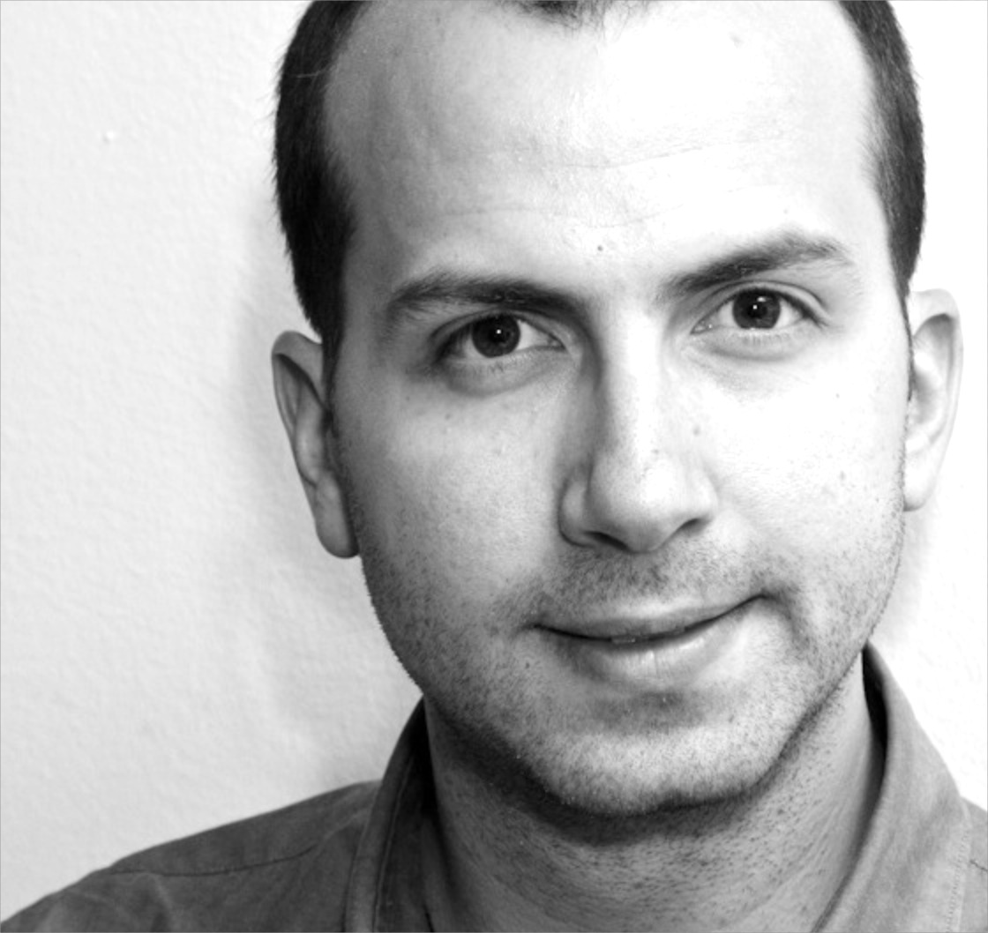
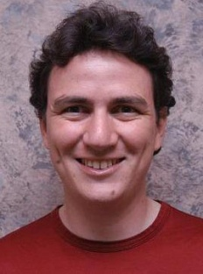
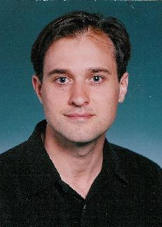
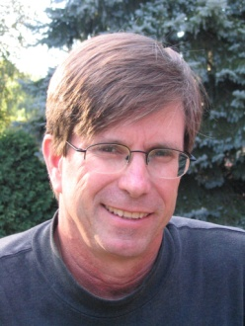

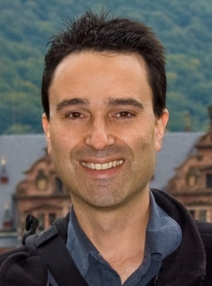
Parallel and Distributed Systems for Probabilistic Reasoning
Thesis Defense
Joseph E. Gonzalez
Thesis Committee:
Carlos Guestrin
University of
Washington & CMU
Guy Blelloch
CMU
David O’Hallaron
CMU
Alex Smola
CMU & Google
Jeff Bilmes
University of
Washington

Slide 2
The foundations of computation have changed …

Slide 3
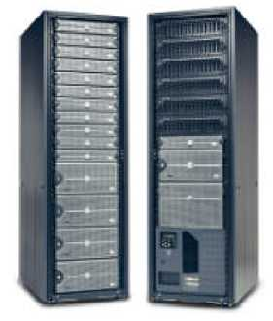
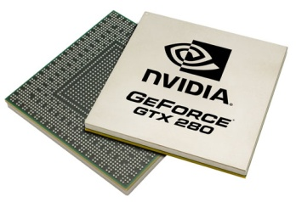
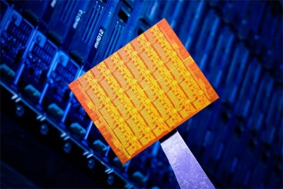
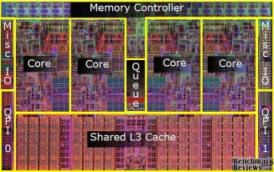

New Parallel and Distributed Platforms
GPUs
Multicore
Clusters
Single Chip
Cloud Computers
Clouds
New Opportunities
  Increased processing and storage
New Challenges
  Parallel algorithm design and implementation

Slide 4
The scale of machine learning problems is exploding …

Slide 5
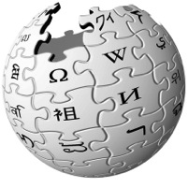



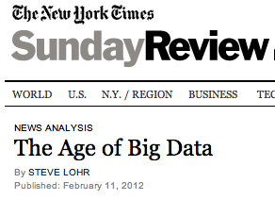
The Age of Big Data
28 Million
Wikipedia Pages
1 Billion
Facebook Users
6 Billion
Flickr Photos
72 Hours a Minute
YouTube
“…growing at 50 percent a year…”
“… data a new class of economic asset, like currency or gold.”

Slide 6
Massive data provides opportunities for structured models…

Slide 7

Example: Estimate Political Bias
?
?
Liberal
Conservative
?
?
?
?
?
?
?
?
Post
?
Post
?
Post
Post
?
Post
Post
Post
Post
?
Post
Post
Post
Post
?
Post
?
Post
?
?
?
?
?
Post
?
Post
Post
Post
Post
Post
Post
?
Post
?
?
?
?
?
?
?

Slide 8
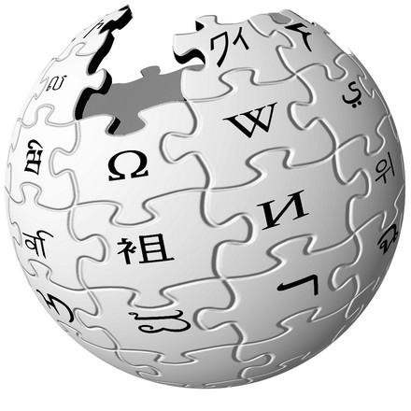


Massive Structured Problems
?
Thesis:
Parallel and Distributed Systems for Probabilistic Reasoning
Advances Parallel Hardware

Slide 9
Thesis Statement: GrAD Methodology
Efficient parallel and distributed systems for probabilistic reasoning:
Graphically decompose computational and statistical dependencies
Asynchronously schedule computation
Dynamically identify and prioritize computation along critical paths

Slide 10
GrAD Methodology: Graphical
Factor statistical and computational dependencies
Improves computational and statistical efficiency
Increases parallelism
Sparse Graph
Independent
Fully Connected
Overly Simplistic
Expressive Tractable
Models & Algorithms
Intractable

Slide 11
Synchronous vs. Asynchronous
Synchronous: compute everything in parallel
Highly parallel – Maximum independent work
Highly inefficient – Many wasted cycles
?
?
?
?
?
?
3
3
3
?
+ + = 9
?
?
?
?
?
?
?
?
?
?
?
Post

Slide 12
GrAD Methodology: Asynchronous
Trigger computation as new information arrives
Capture the flow of information:
  More efficiently use network and processor resources
  Guarantee algorithm correctness
1
1
1
+ + = 3
Post

Slide 13
GrAD Methodology: Dynamic
Dynamically identify and prioritize computation along the critical path
Focus computational resources where most effective:
  Accelerated convergence
  Increased work efficiency

Slide 14
We apply the GrAD methodology to
Probabilistic Graphical Models
Factor statistical models over a sparse graph
Design parallel and distributed algorithms
  Operate on the graphical decomposition
  Asynchronously and dynamically schedule computation
Develop systems that support the design and implementation of GrAD algorithms
Parallel and Distributed Algorithms
for Probabilistic Inference
GraphLab & PowerGraph

Slide 15
Massive Structured Problems
Probabilistic Graphical Models
Parallel and Distributed Algorithms
for Probabilistic Inference
GraphLab & PowerGraph
Advances Parallel Hardware

Slide 16



Encode Probabilistic Structure
Probabilistic Graphical Models
Noisy Pixels
True Image
Noisy Picture

Slide 17
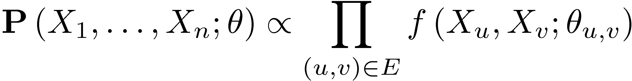
Observed Random Variables
Noisy Pixels
Local Dependencies
Random Variables
True unobserved values
Dependency Graph:
Represent dependencies
Latent Pixel Variables
Parameters:
Characterize probabilities
Joint Probability
Factors
Graph

Slide 18
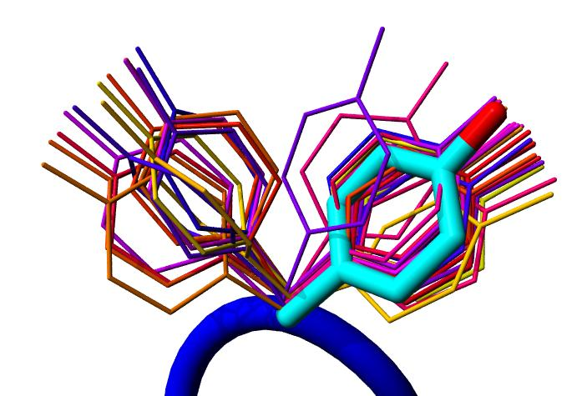

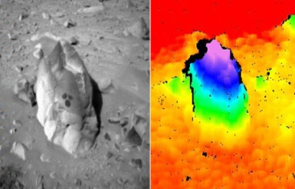
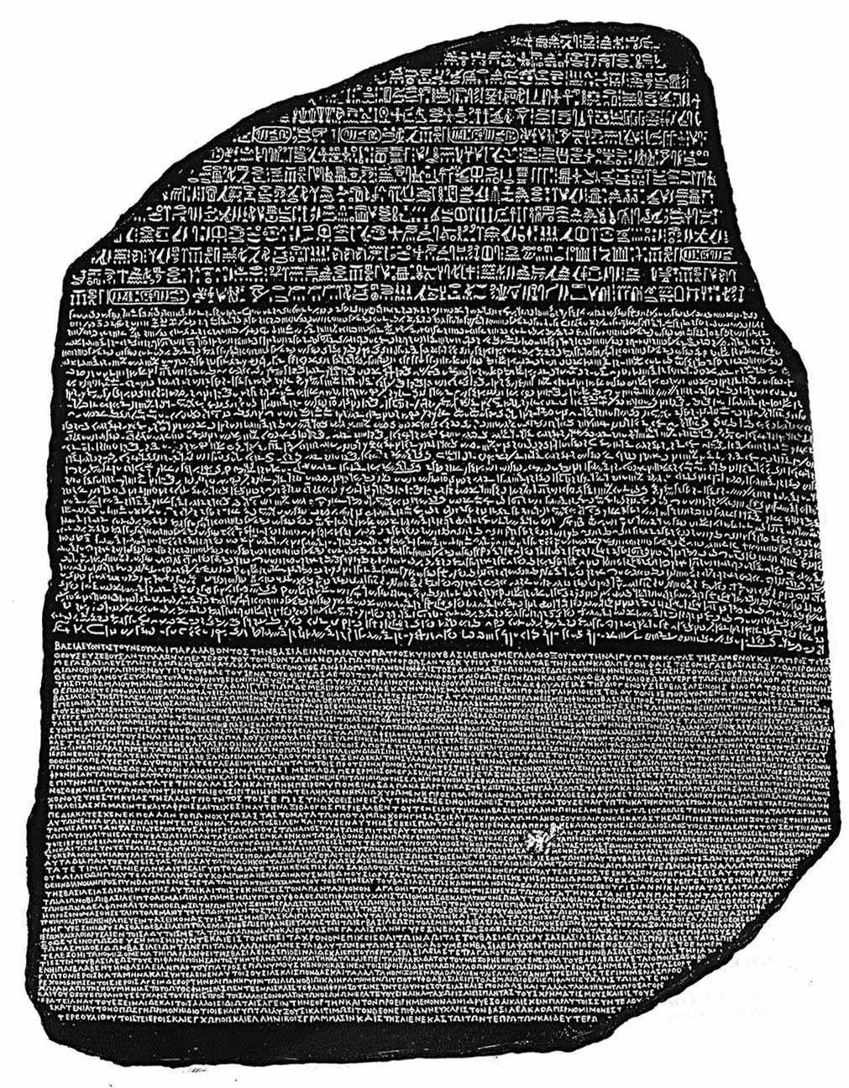
Graphical models provide a common representation
Protein Structure Prediction
Movie Recommendation
Computer
Vision
Machine
Translation
Probabilistic Graphical Models
How are you?

Slide 19
Probabilistic Inference
Making predictions given the model structure and parameters
What is the best
configuration of the
protein side-chains?
Side-Chain
What is the probability
that a particular
pixel is black?
Side-Chain
Side-Chain
Protein Backbone
Side-Chain
Side-Chain
NP-complete in general
  Focus on approximate methods

Slide 20
Parallel and Distributed Algorithms
for Probabilistic Inference
Belief Propagation
Gibbs Sampling

Slide 21
Parallel Belief Propagation
Joint Work With:
Yucheng Low Carlos Guestrin David O’Hallaron
Published Results
AISTATS’09 UAI’09 Chapter in SUML’10

Slide 22
Loopy Belief Propagation (Loopy BP)
Iteratively estimate the variable beliefs
  Read in messages
  Updates marginal
  estimate (belief)
  Send updated
  out messages
Repeat for all variables
until convergence
Notes:
Belief propagation is a message passing algorithm in which messages are sent <click> from variable to factor and then <click> from factor to variable and the processes is repeated. At each phase the new messages are computed using the old message from the previous phase leading to a naturally parallel algorithm known as synchronous Belief Propagation.

Slide 23

Synchronous Loopy BP
Often considered embarrassingly parallel
  Associate processor
  with each vertex
  Receive all messages
  Update all beliefs
  Send all messages
Proposed by:
  Brunton et al. CRV’06
  Mendiburu et al. GECC’07
  Kang,et al. LDMTA’10
  …

Slide 24
Is Synchronous Loopy BP an efficient parallel algorithm?

Slide 25
Sequential Computational Structure

Slide 26
Hidden Sequential Structure

Slide 27
Hidden Sequential Structure
Evidence
Evidence
Running Time:
Time for a single
parallel iteration
Number of Iterations

Slide 28
Optimal Sequential Algorithm
Running
Time
Naturally Parallel
2n²/p
Gap
p ≤ 2n
Sequential (Fwd-Bkwd)
2n
p = 1
Optimal Parallel
n
p = 2

Slide 29
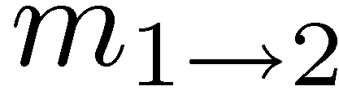
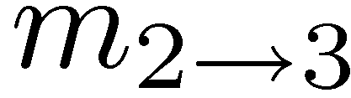
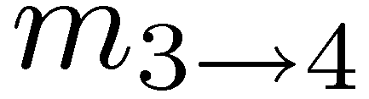
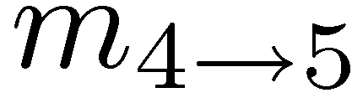
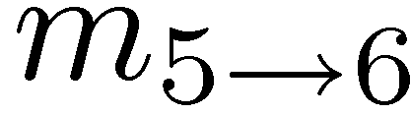
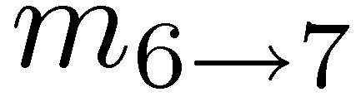
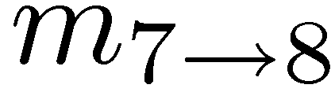
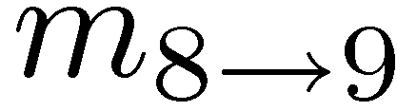
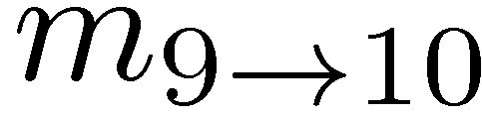
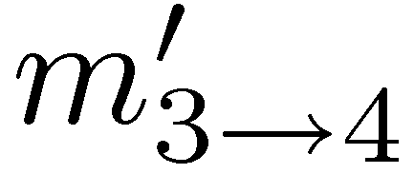
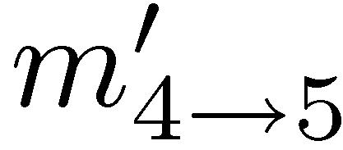
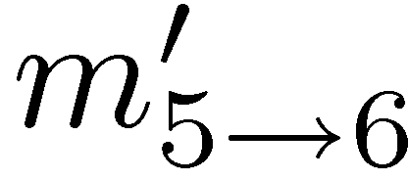
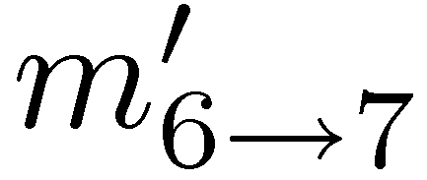
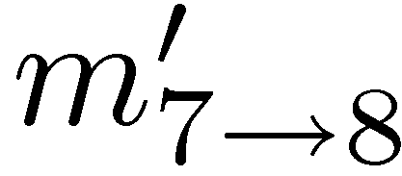
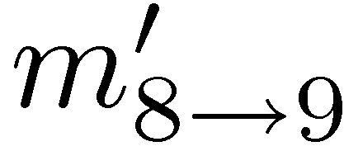
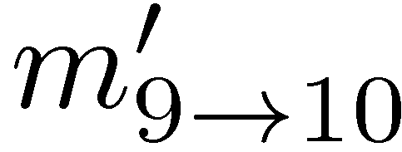
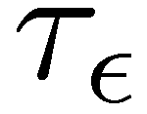
Role of model Parameters on
Sequential Sub-Problems
Epsilon
Change
True Messages
1
2
3
4
5
6
7
8
9
10
τ_{ε} -Approximation
τ_{ε} represents the minimal sequential sub-problem
Captures dependence on model parameters

Slide 30
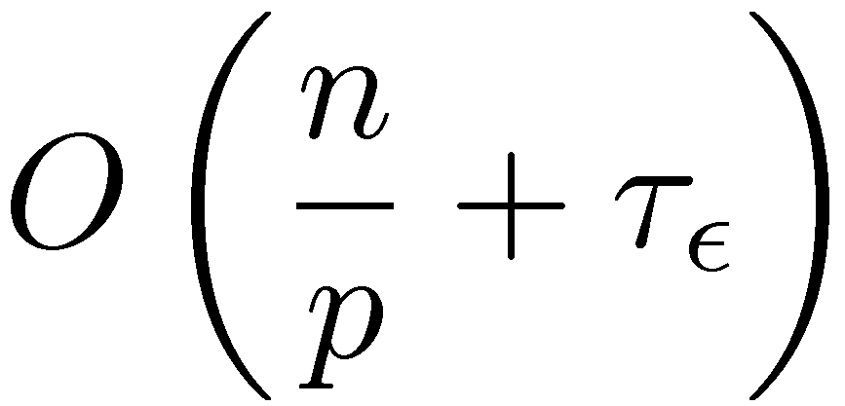
Optimal Parallel Scheduling
Processor 1
Processor 2
Processor 3
Theorem:
Using p processors this algorithm achieves a τ_{ε} approximation in time:
and is optimal for chain graphical models.
Parallel
Component
Sequential
Component

Slide 31
The Splash Operation
Generalize the optimal chain algorithm:
to arbitrary cyclic graphs:
~
Grow a BFS Spanning tree with fixed size
Forward Pass computing all messages at each vertex
Backward Pass computing all messages at each vertex

Slide 32
Running Parallel Splashes
Local State
Local State
Local State
CPU 1
CPU 2
CPU 3
Splash
Splash
Splash
Partition the graph
Schedule Splashes locally
Transmit the messages along the boundary of the partition

Slide 33
Priorities Determine the Roots
Use a residual priority queue to select roots:
Splash
Local State
?
?
?
Splash
Priority Queue
CPU 1

Slide 34
Dynamic Splashes
Priorities adaptively focus computation by determining the shape and size of each Splash
Low
Priority
High
Priority

Slide 35
Dynamic Splashes automatically identify the optimal splash size
Without Adaptation
With Adaptation
Better

Slide 36

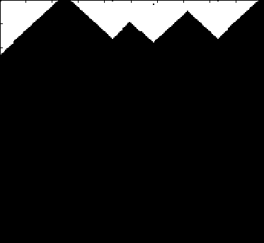
Splash Belief Propagation
Many
Updates
Splash
Synthetic Noisy Image
Few
Updates
Vertex Updates
Algorithm identifies and focuses
on hidden sequential structure
Factor Graph

Slide 37
Evaluation
System Design
  Multicore and distributed implementations
  Development was time consuming
Evaluated on several real-world problems
  Protein interaction and structure prediction
  Markov Logic Networks
Compared against several other variants
  Faster, more efficient, more stable

Slide 38
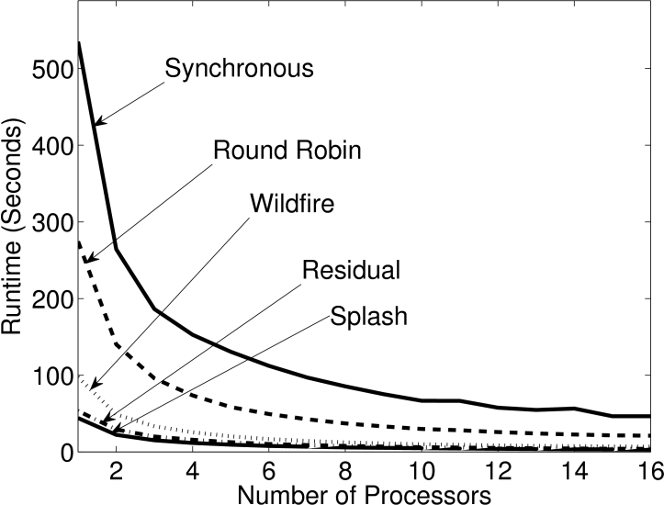
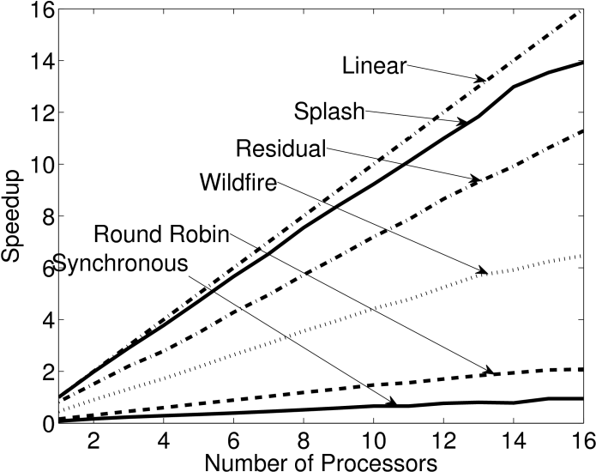
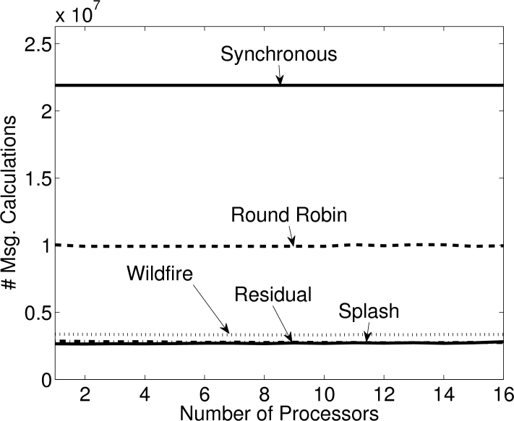
Representative Results
Protein Interaction Models: 14K Vertices, 21K Factors
Runtime
Speedup
Total Work
Synchronous
Theoretical Optimal
Splash
Faster
Synchronous
More
Efficient
Better
Scaling
Splash
Splash
Synchronous
SplashBP converges more often
Achieves better prediction accuracy

Slide 39
Summary: Belief Propagation
Asynchronous + Dynamic → more efficient
  Theoretically and experimentally
  Insight: parallelize optimal sequential algorithm
  Tradeoff: Parallelism & Convergence
Approximation → Increased Parallelism
  Exploit weak interactions (τ_{ε} – approximation)
Key Contributions:
  Demonstrate the importance of dynamic asynchronous scheduling in parallel inference
  Theoretical analysis of work efficiency and relationship to model structure and parameters

Slide 40
GrAD Methodology
Graphical
  BP updates only depend on adjacent vertices
Asynchronous
  Compute messages sequentially within Splash
Dynamic
  Priority scheduling and adaptive Splashes

Slide 41
Additional Related Work
Sequential
Parallel
TRP: Wainwright et al. IEEE Inf. Thr. ‘03
Wildfire: Ranganathan et al. IJCAI’07
ResidaulBP: Elidan et al. UAI’06
Synchronous Asynchronous Async. + Dynamic
Sun et al. ECCV’02
Brunton et al. CRV’06
Mendiburu et al. GECC’07
Kang et al. LDMTA’10
Thesis Work
Parallel and Distributed
WildfireBP, ResidualBP, & SplashBP
Parallel Exact Inference: Pennock et al. UAI’98
Approximate Messages: Ihler et al. JMLR’05

Slide 42
Parallel and Distributed Algorithms
for Probabilistic Inference
Belief Propagation
Gibbs Sampling

Slide 43
Parallel Gibbs Sampling
An asynchronous Gibbs Sampler that
dynamically addresses strong dependencies.
Joint Work With
Yucheng Low Arthur Gretton Carlos Guestrin
Published
AISTATS’11 (Related to work in WSDM’12)

Slide 44
Gibbs Sampling [Geman & Geman, 1984]
Sequentially for each variable in the model
  Select variable
  Use adjacent assignments
  to construct a biased coin
  Flip coin and update
  assignment to variable
Initial Assignment

Slide 45
Can we sample multiple variables in parallel?

Slide 46
From the original paper on Gibbs Sampling:
“…the MRF can be divided into collections of [variables] with each collection assigned to an independently running asynchronous processor.”
-- Stuart and Donald Geman, 1984.
Embarrassingly
Parallel!
Converges to the
wrong distribution!

Slide 47
The problem with
Synchronous Gibbs sampling
t=1
t=2
t=3
Strong Positive
Correlation
t=0
Sequential
Execution
Strong Positive
Correlation
Heads:
Tails:
Strong Negative
Correlation
Parallel
Execution
Adjacent variables cannot be sampled simultaneously.

Slide 48
Introduced Three Convergent Samplers
Chromatic: Use graph coloring to synchronously sample independent sets
Asynchronous: Markov Blanket Locks ensure serializable execution
Splash: Adaptively constructs thin junction tree blocks

Slide 49


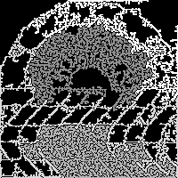
Dynamically Prioritized Sampling
Prioritize Gibbs updates
Adapt the shape of the Splash to span strongly coupled variables:
Noisy Image
BFS Splashes
Adaptive Splashes

Slide 50
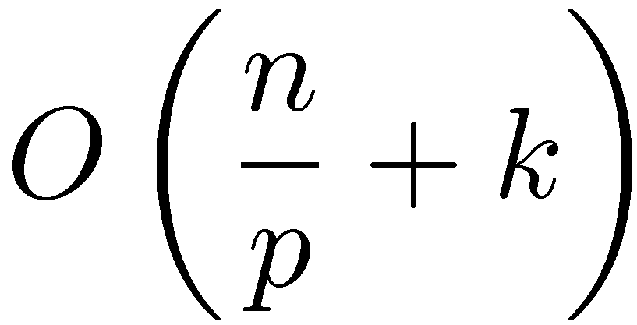
Theorem: Chromatic Sampler
Ergodic: converges to the correct distribution
  Based on graph coloring of the Markov Random Field
Quantifiable acceleration in mixing
Time to update
all variables once
# Variables
# Colors
# Processors

Slide 51
Theorem
Asynchronous and Splash Gibbs Sampler
Ergodic: converges to the correct distribution
  Requires vanishing adaptation
  Corrected an error in a result by Levin & Casella J. Multivar. Anal. ’06
Expected Parallelism:
Max Degree
# Processors
# Variables

Slide 52
Evaluation
Implemented multicore version:
  Built using a GraphLab prototype
    Substantially shorter development time
  Novel junction tree construction algorithm
  Markov blanket locking protocol
Evaluated on large real-world problems

Slide 53
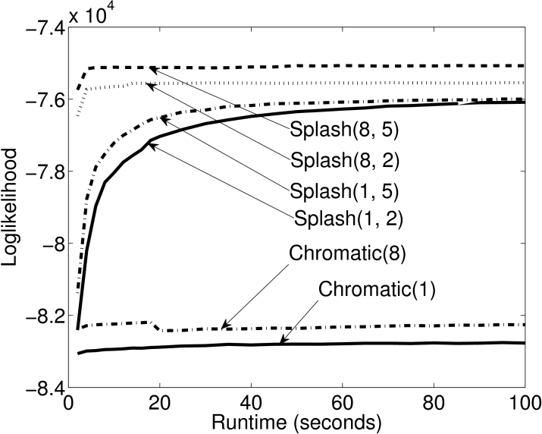
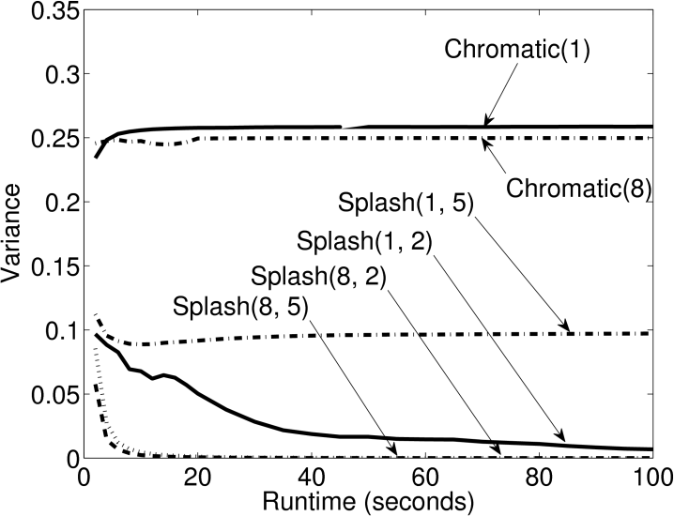
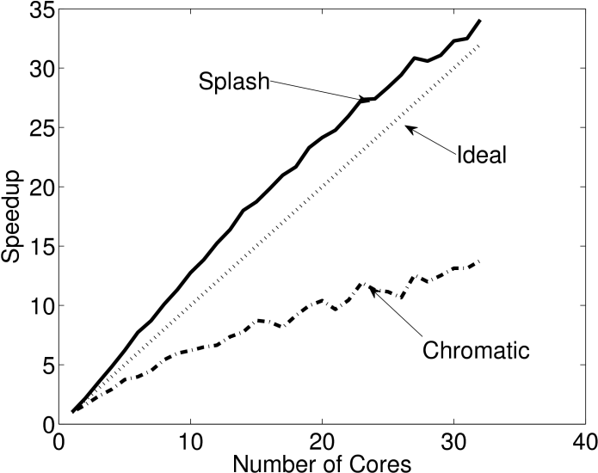
Experimental Results
Markov logic network with strong dependencies
10K Variables 28K Factors
Likelihood
Final Sample
Speedup in Sample Generation
“Mixing”
Splash
Splash
Better
Chromatic
Better
Chromatic
Better
Chromatic
Splash
The Splash sampler outperforms the Chromatic sampler on models with strong dependencies

Slide 54
Contributions: Gibbs Sampling
Proposed three convergent Gibbs samplers
  Chromatic, Asynchronous, Splash
  Spectrum partially synchronous to asynchronous
  New algorithms for junction tree construction
Theoretical analysis of parallel Gibbs sampling
  Convergence of asynchronous blocking
  Relate parallelism to model structure
  Stationary distribution of synchronous sampler
Experimental analysis on real-world problems and systems

Slide 55
GrAD Methodology
Graphical
  Gibbs updates depend only on neighbors in MRF
Asynchronous
  Graph Coloring and Markov Blanket Locks
Dynamic
  Prioritized updates and adaptive Splash

Slide 56
Related Work
Ergodic
(Convergent)
Thesis
Chromatic,
Asynchronous,
and
Splash Gibbs
Parallel &
Distributed
Geman & Geman. Pami ’84
Trees: Hamze et al. UAI’04
Dynamic Blocking: Barbu et al. IEEE Trans Pattern Analysis ‘05
LDA & Bayesian Networks
Newman et al. NIPS’07
Asuncion et al. NIPS’08
Yan et al. NIPS’09
Amr et al. WSDM’12
Asynchronous approximations empirically perform well

Slide 57
Massive Structured Problems
Probabilistic Graphical Models
Parallel and Distributed Algorithms
for Probabilistic Inference
GraphLab & PowerGraph
Advances Parallel Hardware

Slide 58
Parallel Algorithms for Probabilistic Inference
GraphLab & PowerGraph
Parallel Hardware
Joint Work With
Yucheng Low Aapo Kyrola Haijie Gu Danny Bickson
Carlos Guestrin Joe Hellerstein Guy Blelloch David O’Hallaron
Published Results
UAI’10 VLDB’12

Slide 59
How do we design and implement
GrAD Algorithms
We could:
design and implement for each architecture?
  Time consuming
  Repeatedly solving the same system problems
use high-level abstractions like MapReduce?
  Unable to express:
    Graphical
    Asynchronous
    Dynamic
Solution: GraphLab
GrAD Methodology

Slide 60
GraphLab is a
Graph-Parallel Abstraction
Data-Parallel Graph-Parallel
Map Reduce
GraphLab
Independent Data
Single Pass
Synchronous
Graph Structured Data
Iterative Computation
Dynamic + Asynchronous

Slide 61
The GraphLab Abstraction
A user-defined Vertex Program runs on each vertex
Graph constrains interaction along edges
  Directly read and modify the state of adjacent vertices and edges
Parallelism: run multiple vertex programs simultaneously

Slide 62
The GraphLab Vertex Program
Vertex Programs directly access adjacent vertices and edges
GraphLab_PageRank(i)
// Compute sum over neighbors
total = 0
foreach( j in neighbors(i)):
total = total + R[j] * w_{ji}
// Update the PageRank
R[i] = total
// Trigger neighbors to run again
priority = |R[i] – oldR[i]|
if R[i] not converged then
signal neighbors(i) with priority
R[4] * w₄₁
4
+
1
R[3] * w₃₁
R[2] * w₂₁
+
3
2
Dynamics

Slide 63
GraphLab is Asynchronous
The scheduler determines the order that vertices are executed
CPU 1
b
c
d
a
b
c
Scheduler
e
f
b
e
f
g
a
i
h
i
j
h
i
j
k
CPU 2
Scheduler can prioritize vertices.

Slide 64
GraphLab is Serializable
Conflict
Edge
Conflict
Edge
Automatically ensures serializable executions

Slide 65
Serializable Execution
For each parallel execution, there exists a sequential execution of vertex-programs which produces the same result.
CPU 1
time
Parallel
CPU 2
Sequential
Single
CPU

Slide 66
The GraphLab System
Implemented as a C++ API
  Widely downloaded open-source project
Multicore and distributed versions:
  Hide Latency: Pipelined locking
  Fault Tolerance: Chandy-Lamport Snapshot
Tested on a wide range of ML algorithms
  ALS, BP, Gibbs, Lasso, CoEM, SVM, LDA, …

Slide 67
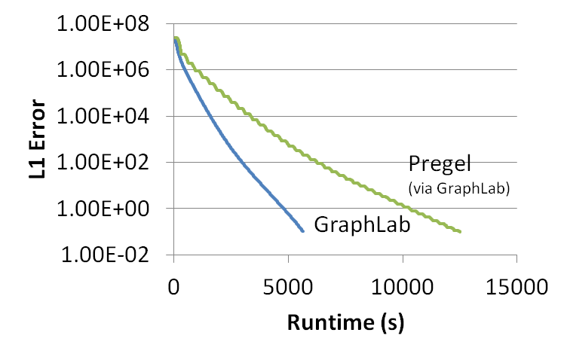
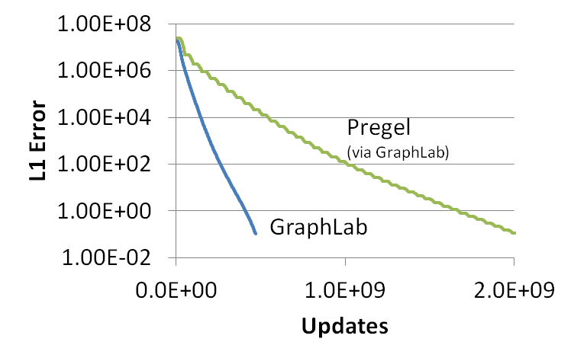
GraphLab vs. Pregel (BSP)
Better
51% updated only once!
PageRank (25M Vertices, 355M Edges)

Slide 68
Never Ending Learner Project (CoEM)
Better
Optimal
Hadoop (BSP) | 95 Cores | 7.5 hrs
GraphLab | 16 Cores | 30 min
GraphLab CoEM
Distributed GraphLab | 32 EC2 machines | 80 secs
6x fewer CPUs!
15x Faster!
0.3% of Hadoop time

Slide 69
Summary: GraphLab
Generalizes the GrAD Methodology
  ALS, BP, Gibbs, Lasso, CoEM, SVM, PageRank, LDA, …
Simplifies the design and implementation of GrAD Algorithms
Substantially outperforms existing systems
Key Contributions:
  Formalized the graph-parallel setting
  Isolates computation from movement of data
  Strong serializability guarantees
  Evaluation on a wide range of algorithms

Slide 70
GraphLab provided exciting scaling performance
Thus far…
But…
We couldn’t scale up to
Altavista Webgraph from 2002
1.4B vertices, 6.6B edges

Slide 71
Parallel Algorithms for Probabilistic Inference
GraphLab & PowerGraph
Parallel Hardware
Joint Work With
Yucheng Low Aapo Kyrola Haijie Gu Danny Bickson
Carlos Guestrin Joe Hellerstein Guy Blelloch David O’Hallaron
Published Results
OSDI’12

Slide 72


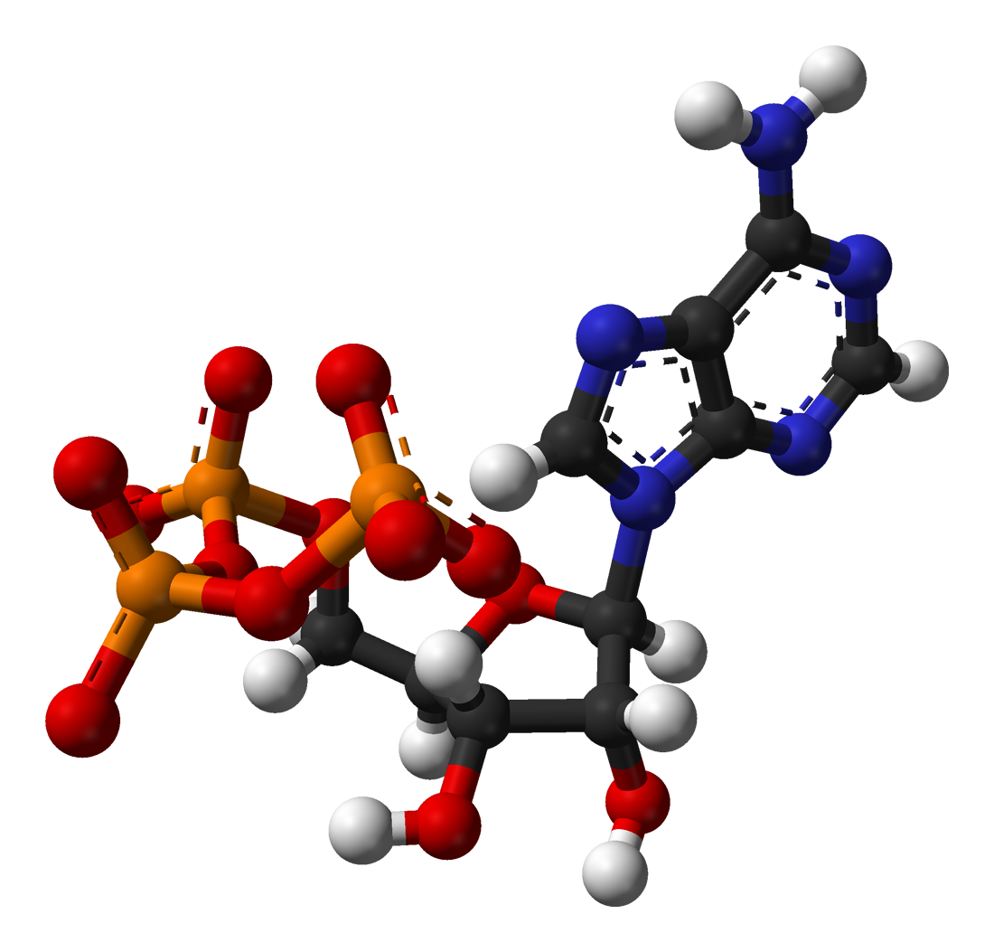




Natural Graphs
Graphs derived from natural phenomena

Slide 73
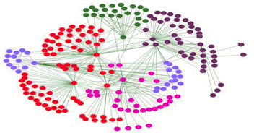
Properties of Natural Graphs
Regular Mesh
Natural Graph
Power-Law Degree Distribution

Slide 74
Power-Law Degree Distribution
More than 10⁸ vertices
have one neighbor.
High-Degree
Vertices
Top 1% of vertices are adjacent to
50% of the edges!
-Slope = α ≈ 2
Number of Vertices
AltaVista WebGraph
1.4B Vertices, 6.6B Edges
Degree

Slide 75

Power-Law Degree Distribution
“Star Like” Motif
President
Obama
Followers

Slide 76

Challenges of High-Degree Vertices
Sequentially process
edges
Touches a large
fraction of graph
Edge meta-data
too large for single
machine
Serializability Requires
Heavy Locking

Slide 77
Graph Partitioning
Graph parallel abstractions rely on partitioning:
  Minimize communication
  Balance computation and storage
Machine 1
Machine 2
Comm. Cost
O(# cut edges)

Slide 78
Power-Law Graphs are
Difficult to Partition
CPU 1
CPU 2
Power-Law graphs do not have low-cost balanced cuts [Leskovec et al. 08, Lang 04]
Traditional graph-partitioning algorithms perform poorly on Power-Law Graphs.
[Abou-Rjeili et al. 06]

Slide 79
Random Partitioning
GraphLab resorts to random (hashed) partitioning on natural graphs
Machine 1
Machine 2
10 Machines → 90% of edges cut
100 Machines → 99% of edges cut!

Slide 80
In Summary
GraphLab is not well suited for
natural graphs
CPU 1
CPU 2
Challenges of high-degree vertices
Low quality partitioning

Slide 81
PowerGraph
Program
For This
Run on This
Machine 1
Machine 2
Split High-Degree vertices
New Abstraction → Equivalence on Split Vertices

Slide 82
A Common Pattern for
Vertex-Programs
GraphLab_PageRank(i)
// Compute sum over neighbors
total = 0
foreach( j in neighbors(i)):
total = total + R[j] * w_{ji}
// Update the PageRank
R[i] = total
// Trigger neighbors to run again
priority = |R[i] – oldR[i]|
if R[i] not converged then
signal neighbors(i) with priority
Gather Information
About Neighborhood
Update Vertex
Signal Neighbors &
Modify Edge Data

Slide 83
GAS Decomposition
Machine 1
Machine 2
Master
Gather
Y’
Y’
Y’
Y’
Σ₁
Σ
Σ₂
+ + +
Mirror
Apply
Y
Y
Y
Y
Machine 3
Machine 4
Scatter
Σ₃
Σ₄
Mirror
Mirror

Slide 84
Minimizing Communication in PowerGraph
Communication is linear in
the number of machines
each vertex spans
New Theorem:
For any edge-cut we can directly construct a vertex-cut which requires strictly less communication and storage.
Y
Y
Y
A vertex-cut minimizes
machines each vertex spans
  Percolation theory suggests that power law graphs have good vertex cuts. [Albert et al. 2000]

Slide 85
Constructing Vertex-Cuts
Evenly assign edges to machines
  Minimize machines spanned by each vertex
Assign each edge as it is loaded
  Touch each edge only once
Propose two distributed approaches:
  Random Vertex Cut
  Greedy Vertex Cut

Slide 86
Random Vertex-Cut
Randomly assign edges to machines
Machine 1
Machine 2
Machine 3
Balanced Vertex-Cut
Y
Spans 3 Machines
Y
Y
Y
Y
Y
Z
Y
Z
Y
Y
Y
Z
Z
Spans 2 Machines
Not cut!

Slide 87
Random Vertex-Cuts vs. Edge-Cuts
Expected improvement from vertex-cuts:
Order of Magnitude
Improvement

Slide 88
Greedy Vertex-Cuts
Place edges on machines which already have the vertices in that edge.
Machine1
Machine 2
A
B
B
C
A
B
D
E

Slide 89
Greedy Vertex-Cuts Improve Performance
Greedy partitioning improves
computation performance.

Slide 90
System Design
PowerGraph (GraphLab2) System
MPI/TCP-IP
PThreads
HDFS
EC2 HPC Nodes
Implemented as C++ API
Uses HDFS for Graph Input and Output
Fault-tolerance is achieved by check-pointing
  Snapshot time < 5 seconds for twitter network

Slide 91
PageRank on the Twitter Follower Graph
Natural Graph with 40M Users, 1.4 Billion Links
Communication
Runtime
Total Network (GB)
Seconds
PowerGraph
PowerGraph
Reduces Communication
Runs Faster
32 Nodes x 8 Cores (EC2 HPC cc1.4x)

Slide 92


PowerGraph is Scalable
Yahoo Altavista Web Graph (2002):
One of the largest publicly available web graphs
1.4 Billion Webpages, 6.6 Billion Links
7 Seconds per Iter.
1B links processed per second
30 lines of user code
64 HPC Nodes
1024 Cores (2048 HT)

Slide 93
Topic Modeling
English language Wikipedia
  2.6M Documents, 8.3M Words, 500M Tokens
  Computationally intensive algorithm
100 Yahoo! Machines
Specifically engineered for this task
64 cc2.8xlarge EC2 Nodes
200 lines of code & 4 human hours
PowerGraph

Slide 94
Triangle Counting on The Twitter Graph
Identify individuals with strong communities.
Counted: 34.8 Billion Triangles
Hadoop
[WWW’11]
1536 Machines
423 Minutes
64 Machines
1.5 Minutes
282 x Faster
PowerGraph
Why? Wrong Abstraction →
Broadcast O(degree²) messages per Vertex
S. Suri and S. Vassilvitskii, “Counting triangles and the curse of the last reducer,” WWW’11

Slide 95
Machine Learning and Data-Mining Toolkits
Graph
Analytics
Graphical
Models
Computer
Vision
Clustering
Topic
Modeling
Collaborative
Filtering
PowerGraph (GraphLab2) System
Demonstrates the Applicability
of the GrAD Methodology

Slide 96
Summary: PowerGraph
Identify the challenges of Natural Graphs
  High-degree vertices, Low-quality edge-cuts
Solution PowerGraph System
  GAS Decomposition: split vertex programs
  Vertex-partitioning: distribute natural graphs
PowerGraph theoretically and experimentally outperforms existing graph-parallel systems.

Slide 97

Related High-Level Abstractions
Synchronous
GrAD
Pregel
PowerGraph
[Dean et al. OSDI’04]
Messaging
[PODC’09, SIGMOD’10]
Shared State
[UAI’10, VLDB’12, OSDI’12]
Data-Parallel Graph-Parallel
Others
Spark, Twister, …
Others
Giraph, Golden Orbs,
GPS, BoostPGL, …
Others
Signal-Collect, GraphChi

Slide 98
Massive Structured Problems
Probabilistic Graphical Models
Parallel and Distributed Algorithms
for Probabilistic Inference
GraphLab & PowerGraph
Advances Parallel Hardware

Slide 99
Thesis Statment
Efficient parallel and distributed systems for probabilistic reasoning follow the GrAD Methodology
Graphically decomposition:
  Expose parallelism and distribute state
Asynchronous scheduling
  Improved convergence and correctness
Dynamic prioritization
  Eliminated wasted work

Slide 100
Observations
Graphical models encode statistical, computational, and parallel structure
Tradeoff: Convergence and Parallelism
  Many things can be computed in parallel
  Not all parallel computation is productive
Approximation →Increased Parallelism
  τ_{ε}-approximation, approximate sampling
Power of high-level abstractions
  Enables the exploration of GrAD methodology

Slide 101
Future: Declarative Models
Models are recursive relationships
  BP, Gibbs Sampling, PageRank, …
System determines the optimal schedule
My Interests
Sum of my friends interests
“Closeness”
number of overlapping posts

Slide 102
Future: Online Probabilistic Reasoning
The world is rapidly evolving:
  Make friends and rate movies in real-time
How do we define and maintain models?
  Declarative specification: time invariant
  τ_{ε}-approximation: small change → local effect
Exploit Power-Law structure in change
  Popular items are rated more frequently
  Exploit burstiness for better caching

Slide 103
Contributions & Broader Impact
Theoretically and experimentally characterized
  Importance of dynamic asynchronous scheduling
  Effect of model structure and parameters on parallelism
  Effect of approximation accuracy on parallelism
  Tradeoff between parallelism and convergence
Developed two graph-parallel abstractions
  GraphLab: vertex-centric view of computation
  PowerGraph: Distributed vertex-centric view of computation
Fostered a community around GraphLab/PowerGraph
  Substantial industry and academic interest
Built a foundation for the future design of scalable systems for probabilistic reasoning

Slide 104
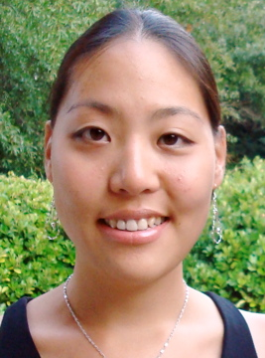




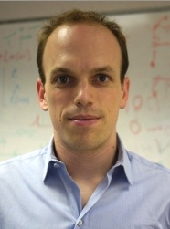
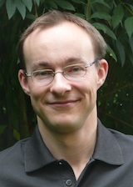


Thank You!
Sue Ann
Hong
Yucheng
Low
Aapo
Kyrola
Haijie
Gu
Danny
Bickson
Arthur
Gretton
Andreas
Krause
Carlos
Guestrin
Alex
Smola
Jeff
Bilmes
David
O’Hallaron
Guy
Blelloch
Joe
Hellerstein
The Select Lab & My Family

